Slide 1

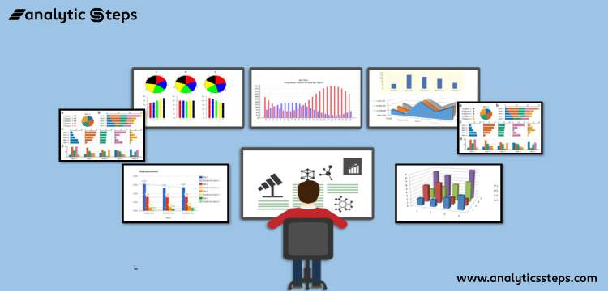

FOUNDATION OF data analysis REVIEW 1
Team Members: KASHISH BAJAJ (20BCE1790)
AKSHIT JAIN (20BCE1818)
AKASH RAJ BEHERA (20BCE1829)

Slide 2
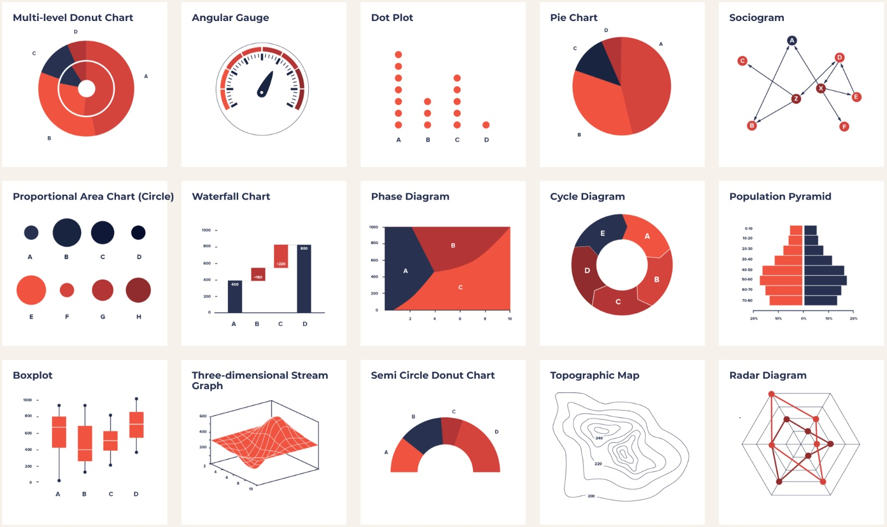
FOUNDATION OF Data Analysis (FDA)
Foundation of data analysis (FDA) is used by data scientists to analyse and investigate data sets and summarize their main characteristics, often employing data visualization methods. It helps determine how best to manipulate data sources to get the answers you need, making it easier for data scientists to discover patterns, spot anomalies, test a hypothesis, or check assumptions.

Slide 3

Talking Point (Topic)
Streaming Content Dashboard

Slide 4
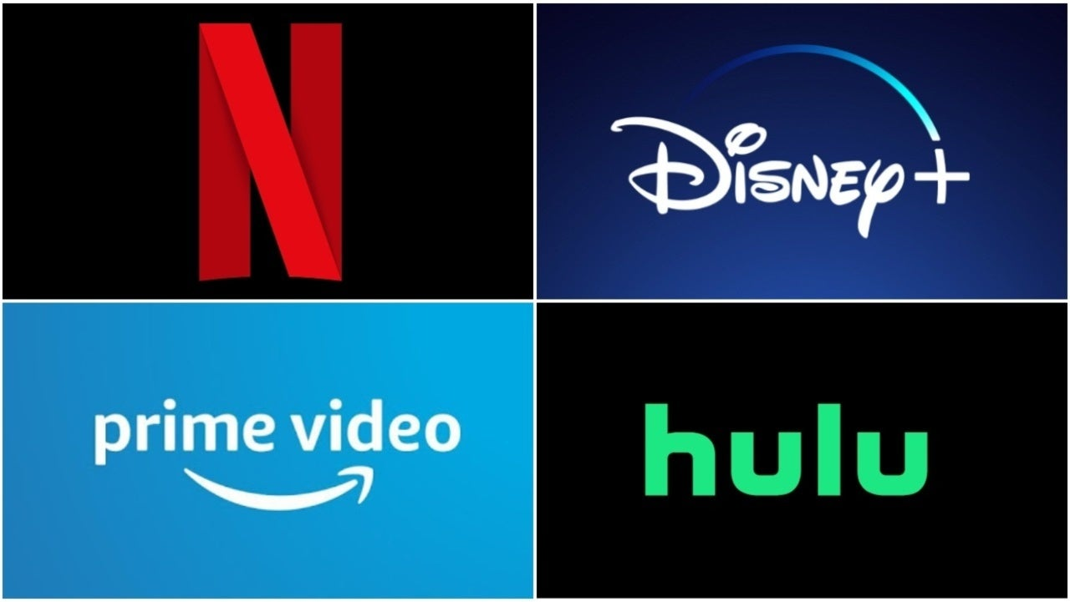

Slide 5

Problem Statement
Data visualization of the combined data from Netflix, Hulu, Disney Plus and Amazon Prime using K-Means and created a recommendation system to find similar movies to what the viewer has watched.

Slide 6

To create visualize various patterns and trend in OTT content from Netflix, Hulu, Amazon prime and Disney Plus. Cleaning the dataset containing the data and pre-processing it. Applying FDA to find Patterns in the data and visualize them. To create interactive dashboard using tableu about OTT content from Netflix, Hulu, Amazon prime and Disney Plus To create a Recommendation System
Objective

Slide 7
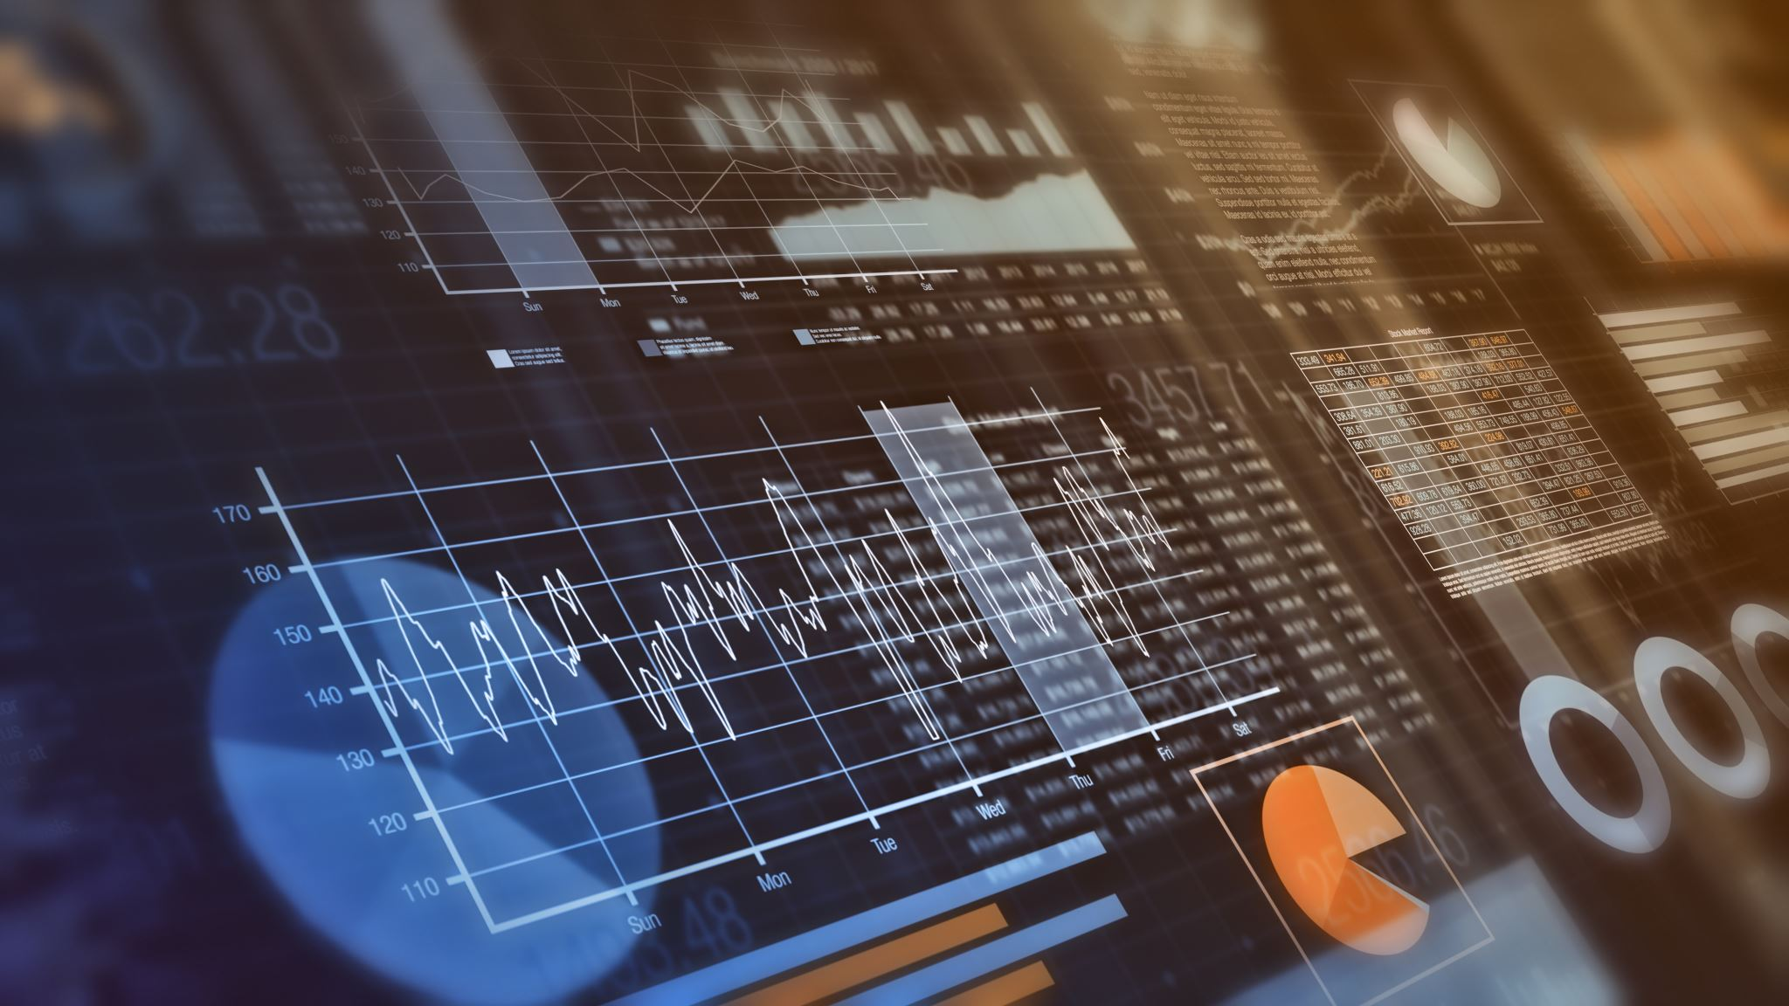
DATASET SPECIFICATIONS AND ILLUSTRATION: -
Since our preferred domain is ‘Recommendation of movies across several OTT platforms' , our team has collectively decided to opt the datasets providing information about the details of variety of movies of different genres, title, director, cast, country, date released .These datasets are obtained from the open source "Kaggle" as guided by our "Hon'ble Ma'am", respectively. The dataset consist of categorical and numerical data. Altogether, there are nearly 40k observations approximately. Further, are the names of datasets we would like to be mentioned as follows: -

Slide 8
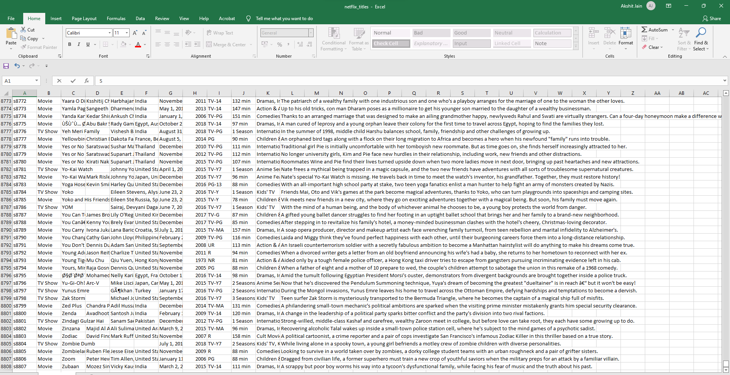
NETFLIX DATASET CONSISTING OF 8808 OBSERVATIONS

Slide 9
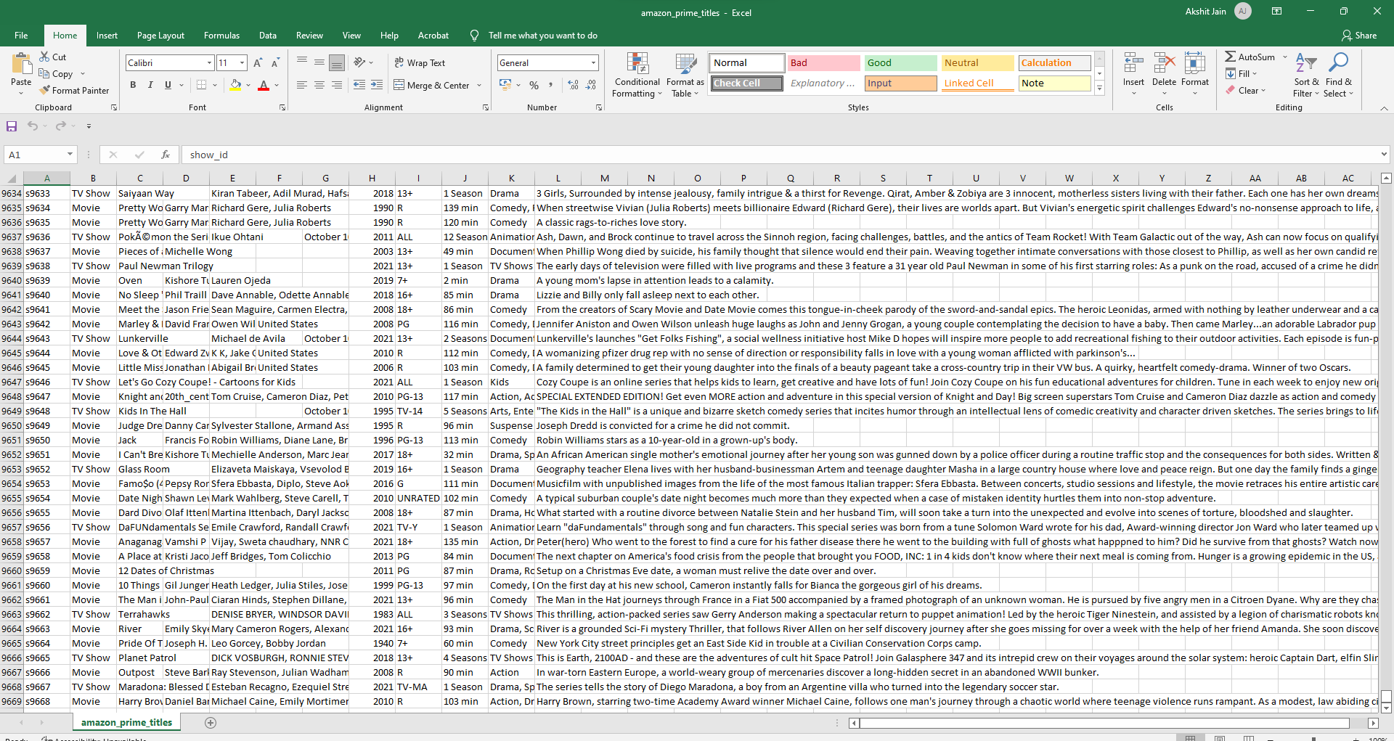
AMAZON PRIME DATASET CONSISTING OF 9669 OBSERVATIONS

Slide 10
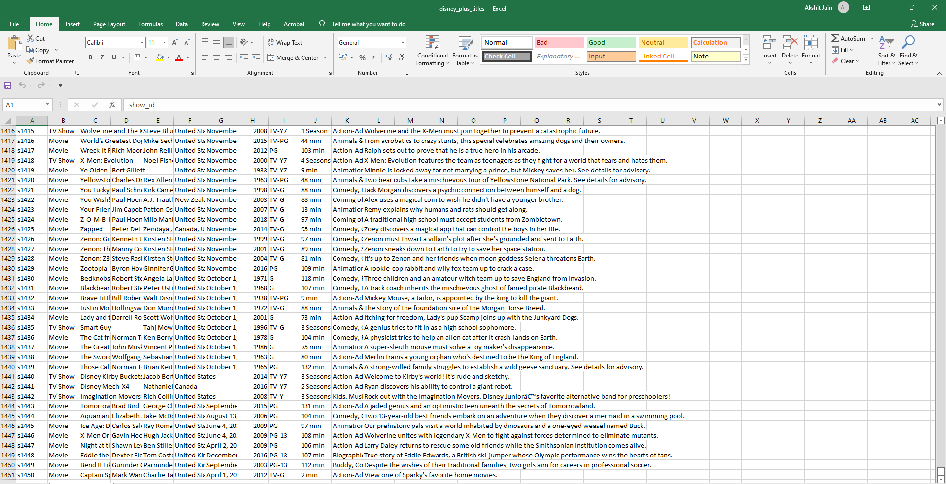
DISNEY PLUS HOTSTAR DATASET CONSISTING OF 1451 OBSERVATIONS

Slide 11
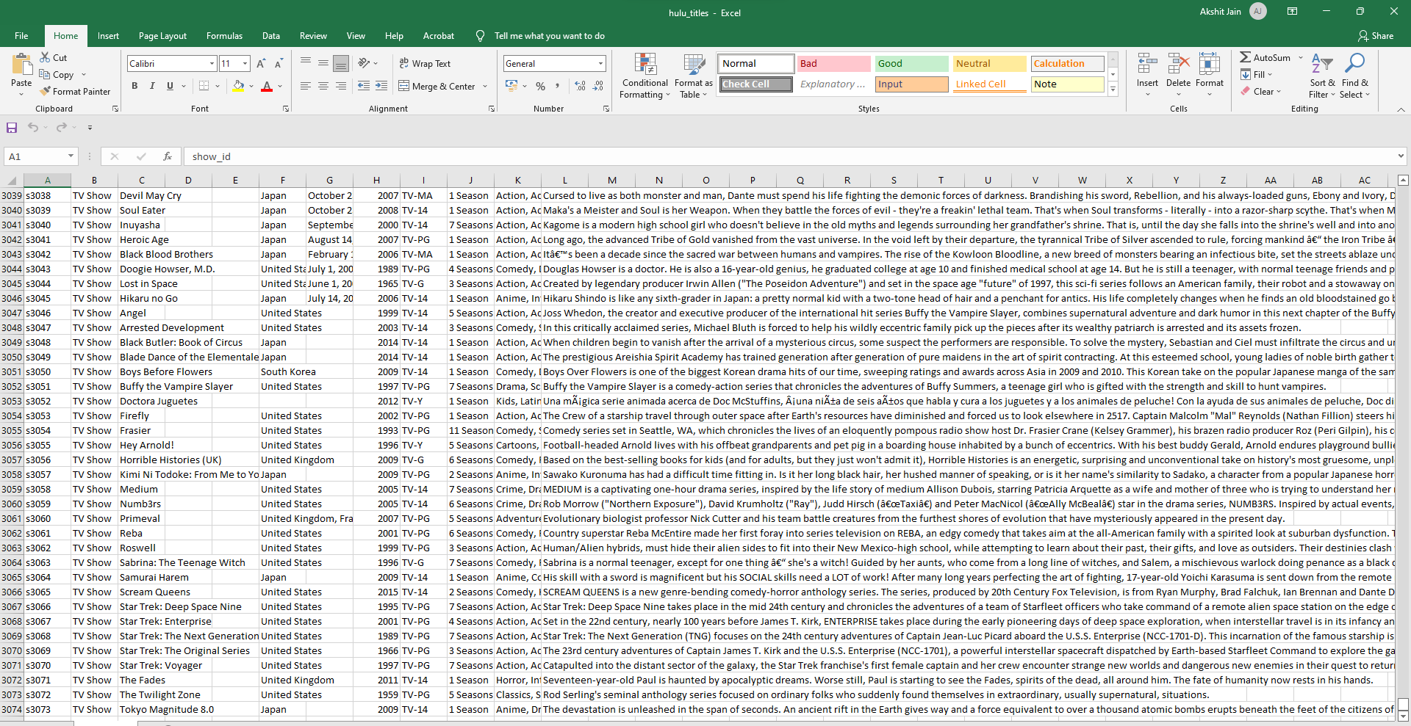
HULU DATASET CONSISTING OF 3074 OBSERVATIONS

Slide 12
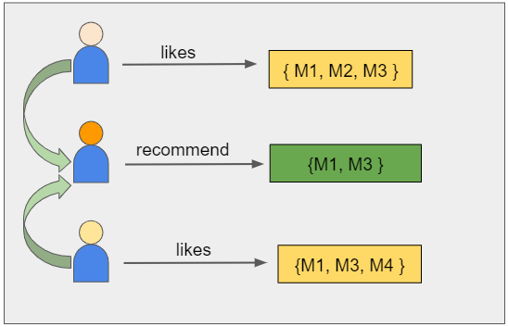
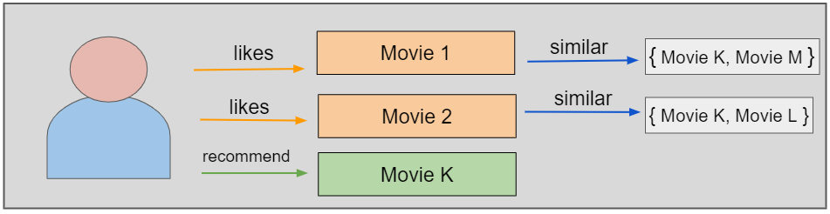
Matrix factorization is a class of collaborative filtering algorithms used in recommender systems. This family of methods became widely known during the Netflix prize challenge due to how effective it was. Matrix factorization algorithms work by decomposing the user-movie interaction matrix into the product of two lower dimensionality rectangular matrices, say U and M. The decomposition is done in such a way that the product results in almost similar values to the user-movie interaction matrix. Here, U represents the user matrix, M represents the movie matrix, n is the number of users, and m is the number of movies.
ALGORITHM
For example, if user A watches M1, M2, and M3, and user B watches M1, M3, M4, we recommend M1 and M3 to a similar user C. You can see how this looks in the figure below for clearer reference.

Slide 13

NOVELTY
The project will be scheduled into 5 Modules: -
• Cleaning, Refining and Pre-processing the Datasets
• With the help of Coding Languages (Mainly Python with its libraries such as Pandas, NumPy, Matplotlib, SciPy etc.), data analysis will be performed accordingly.
• Finding different kinds of patterns and trends as well as visualizing it in the various forms of pictorial representation available in the Jupyter Notebook.
• Noting down the observations , conclusions(interpretations), analysis on predictions using regression and so on.
• On the Final note, presenting the final review after the exploration of data analysis of the datasets chosen, respectively.

Slide 14
From the Visualization we WILL gain a lot of Inferences. Like how each platform values movies more than tv shows. We also found that Amazon and Netflix has the biggest content library with Disney & Hulu slowly building their catalogues. We also saw how US is the biggest producer of OTT Content with India coming at a close Second. We also inferred how the growth of OTT Content libraries has been meteoric in recent years, almost growing exponentially. We also saw the rating distribution between the OTTs and how they favor older teens/Adult markets as their main customer segment. Finally, we WILL created and tested the recommendation engine. We can see how such engines use clustering to reduce runtime dramatically while producing high quality results. This also highlights the importance of clustering data in large corporate environments like multinational OTT providers.
CONCLUSION

Slide 15
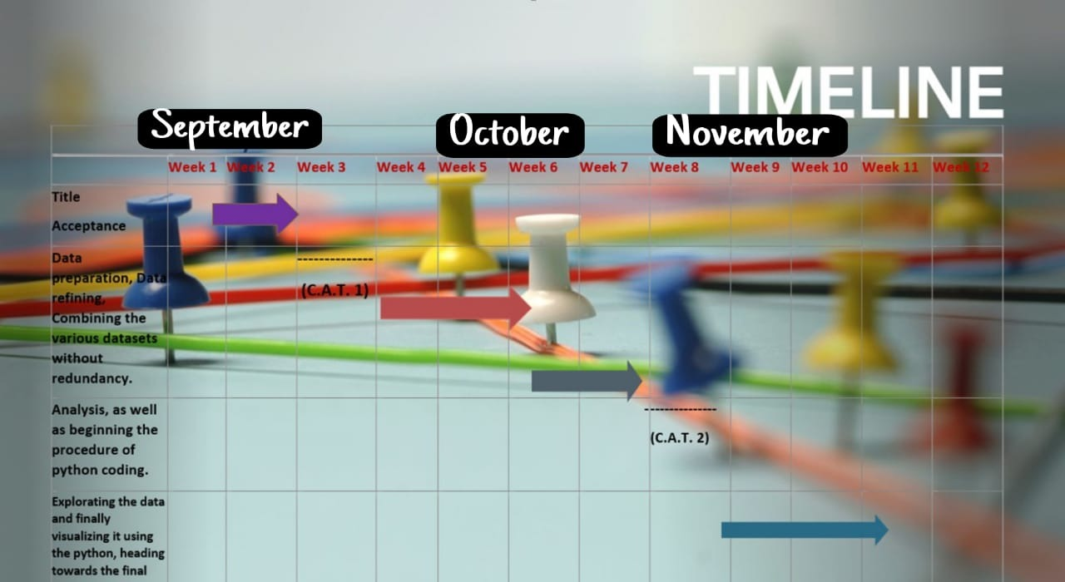

Slide 16
1. https://www.researchgate.net/publication/331966843_Content- Based_Movie_Recommendation_System_Using_Genre_Correlation#:~:text=A%20recommendation%20system%20is%20a,present%20in%20previously%20liked%20movies. 2. https://ieeexplore.ieee.org/document/6382910
REFERENCE

Slide 17
